Slide 1

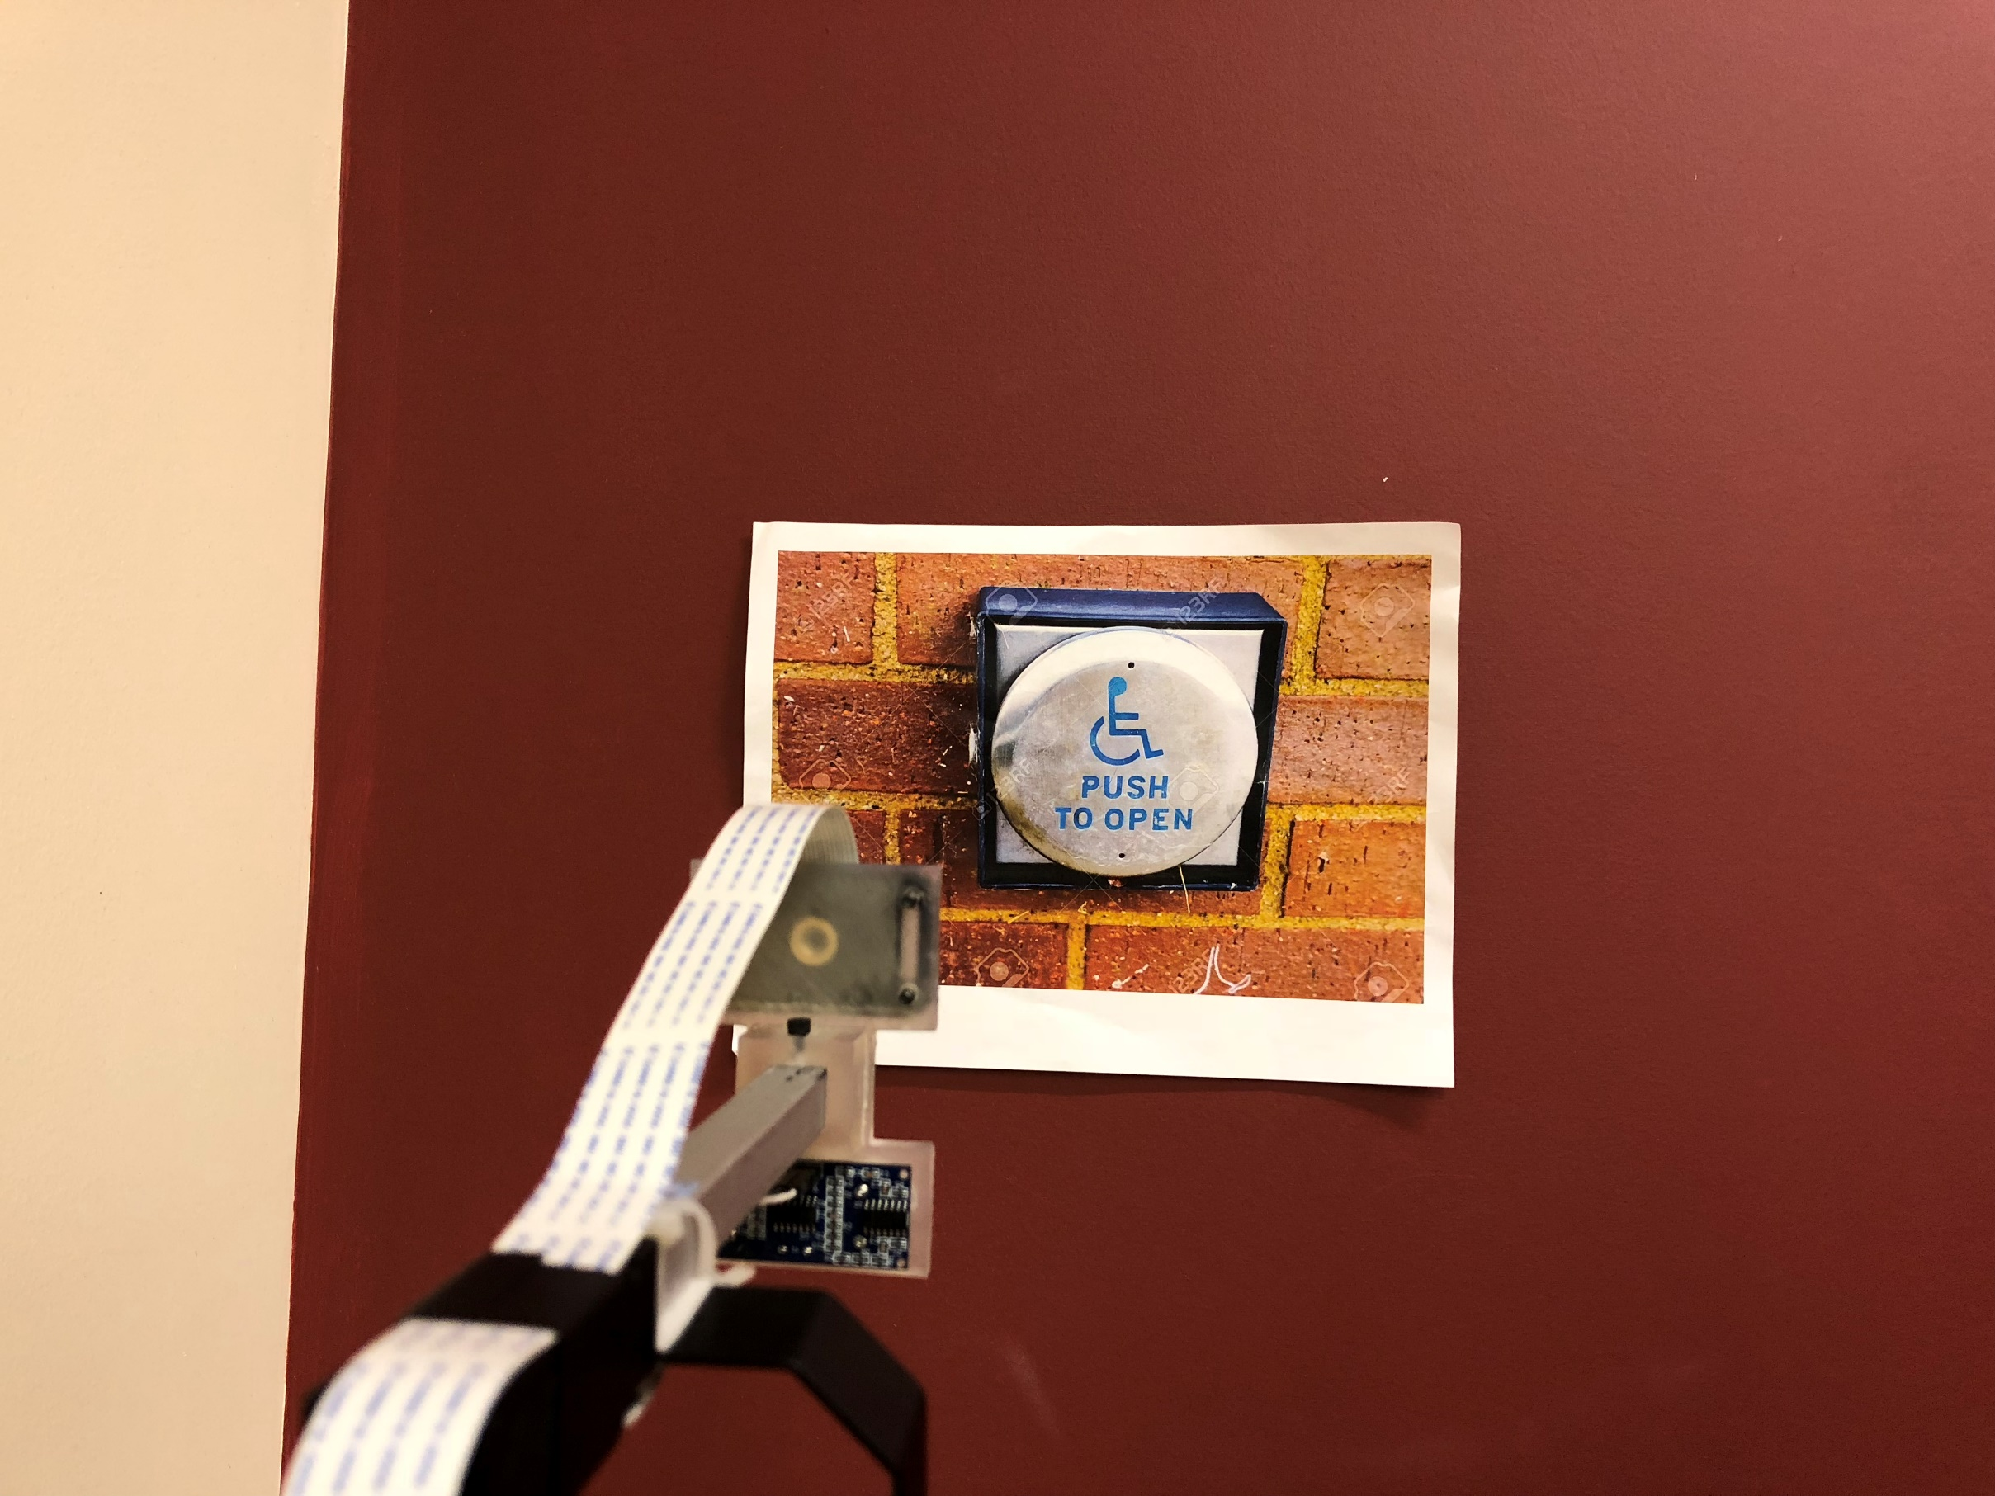
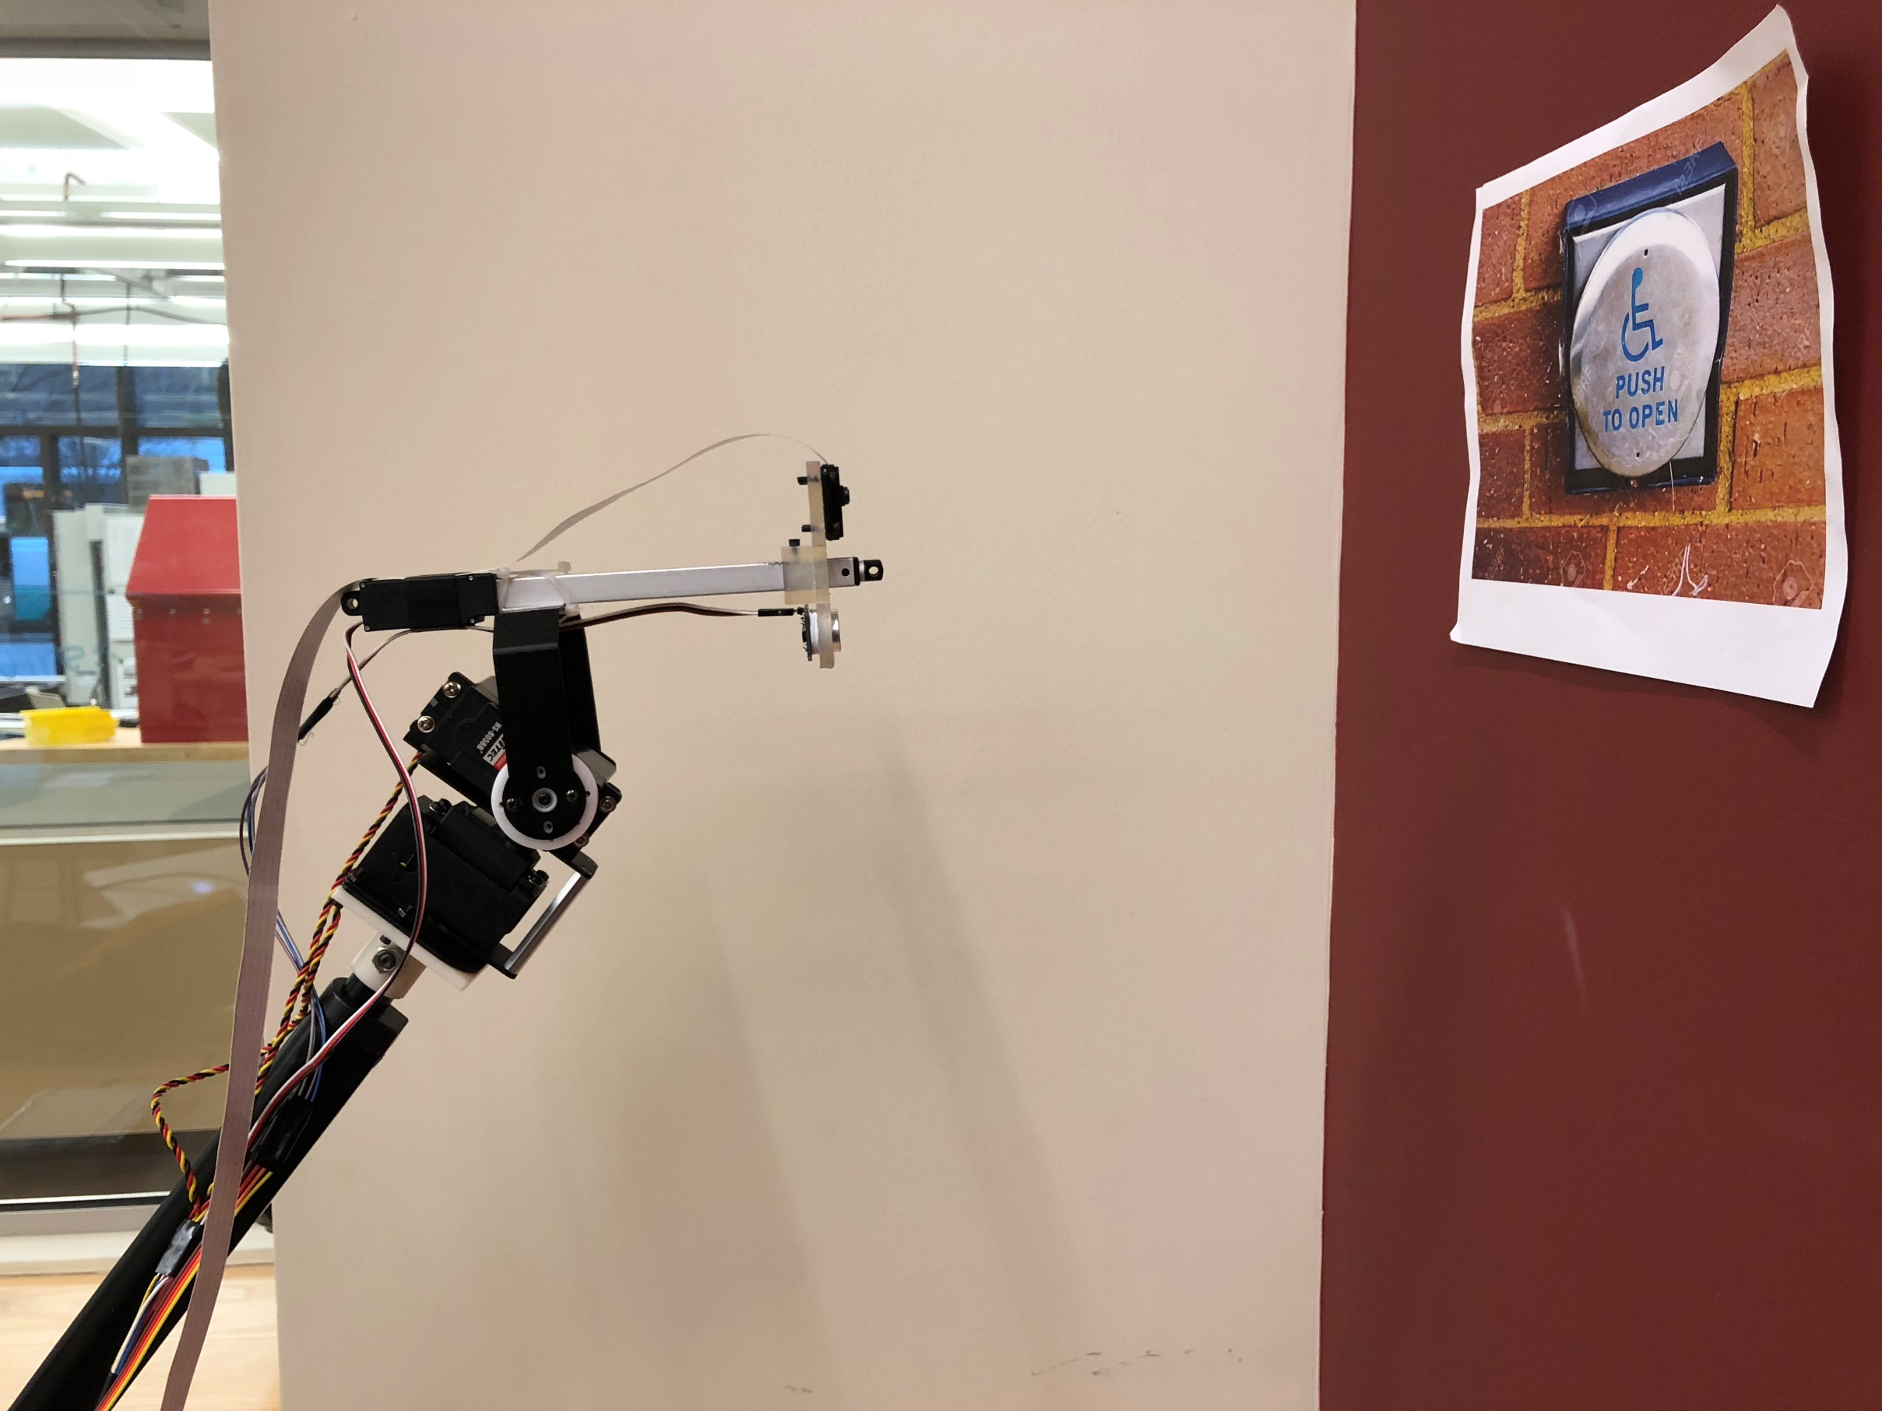
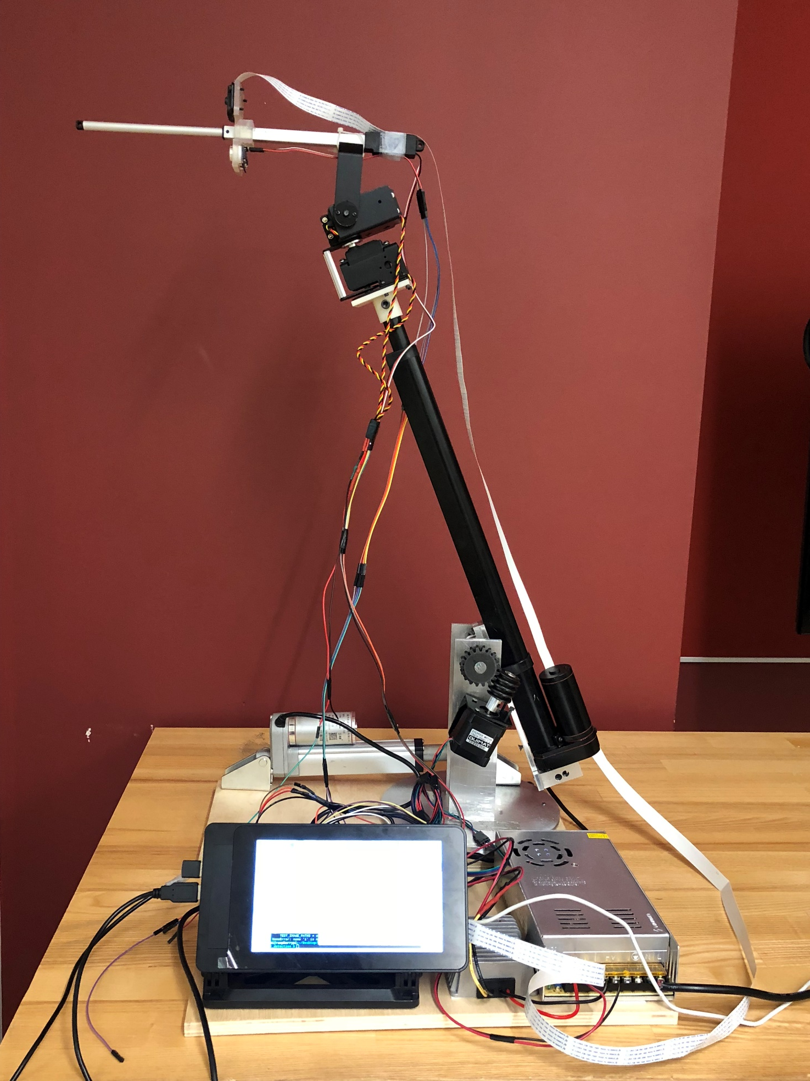


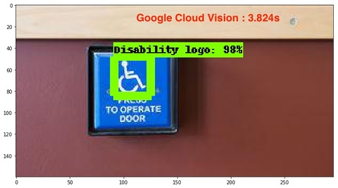
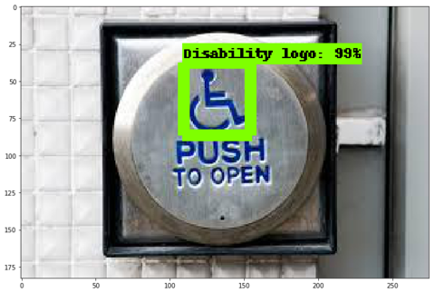
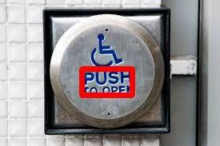


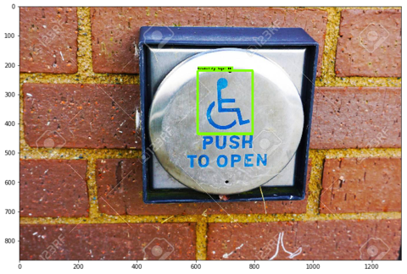
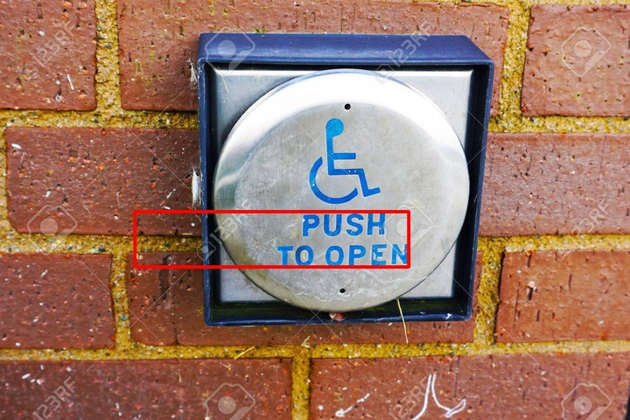
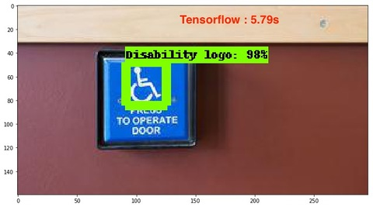

Robotic Arm for Smart Wheelchair
Abhay Sarda, Chenyu Wang Shruthi Sivasubramanian, Rohan Jadeja,
Shengye Li and
Boston University
Electrical and Computer Engineering Department, College of Engineering
User Story
Arm Design
Equations
(a) A robot arm to help the physically challenged to access handicapped doors.
6 Degrees of Freedom, with a maximum extension of 36 inches.
It can support a maximum linear load capacity of 230lbs, with a torque of 3000Ncm⁻¹.
$$Real length=\frac{distance(Z)}{focal length}×length(px)$$
Y
User story
MobileNet SSD Model (TensorFlow)
X
Z
(b) The user can activate the arm by pressing the button.
4. Calculation of 2-D parameters
5. Calculation of depth of view
(c) Our arm searches for a handicapped button in the frame, and activates the door.
1. Complete arm with a Raspberry Pi.
2. Model Accuracy – 86.7%
3. Training and Testing Data
Workflow
Image recognition
Speed Evaluation
Pan to the sides
No
9. Google Cloud Vision on a Raspberry Pi
User presses the button(UI)
Arm goes to default positions
Capture photo
Button present?
Yes
Yes
Arm in desired position?
10. Tensorflow running on the Raspberry Pi.
Communicate with Arduino
Computer arm parameters
No
7. Current workflow
8. Logo Detection
8. Google Cloud Vision OCR
Note : All values reported are an average over 5 runs, and running on a single thread on the raspberry pi, without GPU acceleration.

